Slide 1
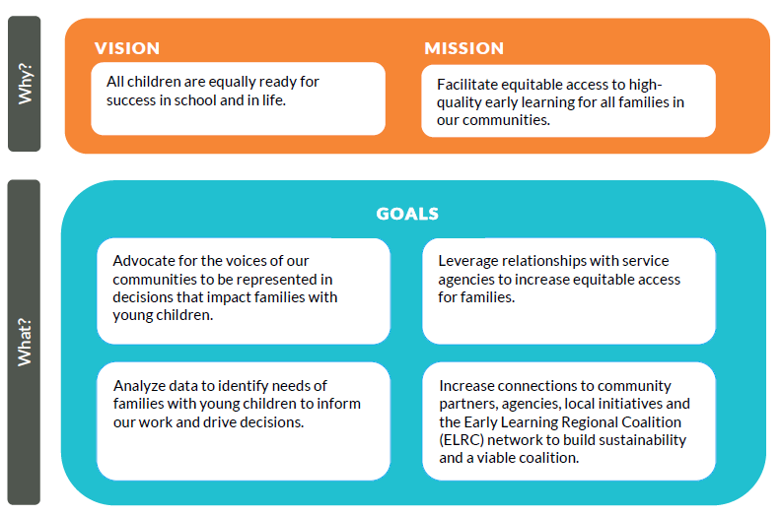
Strategic Framework (updated June 2018)
Fiscal Agent and Staff Support
Funding partners

Slide 2
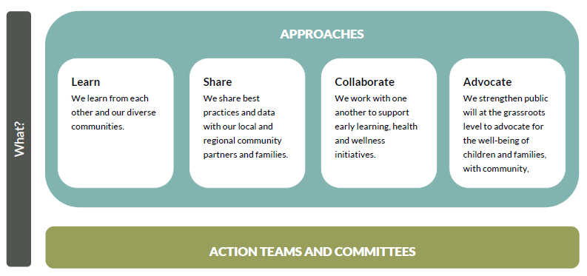
Strategic Framework (updated June 2018)
Who is our community?
A network of 30 providers in early learning, K-12, health and human services. The full coalition convenes monthly; the action teams on their own schedules.
We have six action teams and two governing committees who set plans and priorities that align with both the approaches listed here and with their own organizational missions.
We are an organized platform for service providers who are working FOR families with young children; we are not comprised OF families.
We play a key role in elevating family voice to state and federal agency decision makers; we leverage our roles in the middle, similar to how middle managers serve as powerful change agents.

Slide 3
Addressing Systemic Inequity:
Creating Local Systems-Level Efficiencies
Home Visiting Collaborative (meets monthly)
30 Home Visiting programs across Yakima and Kittitas Counties
Coordinates referrals, recruitment efforts, and shared professional development
In 2017, there were 700 state and federal home visiting slots in Yakima County, and nearly 6,000 children under 5 living in poverty¹.
To mitigate this vast service delta, this group’s guiding principle is to ensure families are matched to the best fit and programs are full.
The interest convergence of individual program success and coordinating resources to serve families provides value to individual programs, incentivizing participation which leads to its continued success.

Slide 4
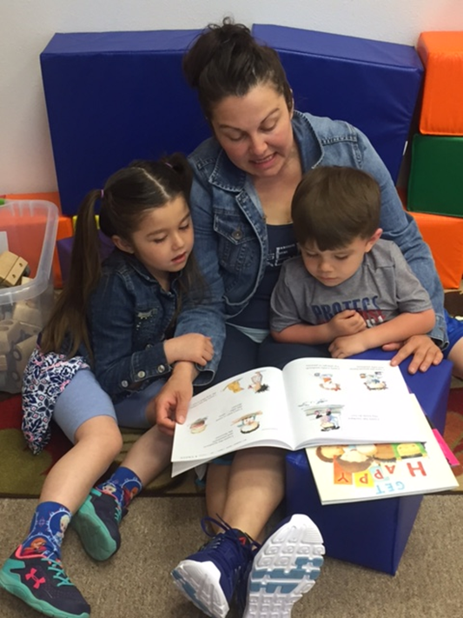
Community Engagement
Kaleidoscope Model Play and Learn Groups-located at
DSHS Community Service Offices
Operated by Catholic Charities Serving Central WA in
partnership with local CSO Administrators and staff
Tuesdays: Sunnyside; Thursdays, Yakima
Feb 2017-April 2018
1,445 children, 1,090 parents/caregivers
Highly skilled bilingual facilitators create rapport quickly, affirm parents/caregivers for the good they are doing with their children, play and bonding is the primary focus
Co-location of services meets parents/caregivers where they are and values families as worthy of a comfortable, inviting space

Slide 5
Challenges, Obstacles, Lessons Learned
As a community of service providers we can:
share voice and concerns from the families we serve,
coordinate referrals and recruitment to benefit all programs,
meet during the regular work day as part of paid work,
create cross-sector partnerships,
connect with elected officials in ways that publicly-funded entities can’t.
As a community of service providers we can’t:
claim that we are a coalition OF families,
connect with Family, Friend, and Neighbor providers (if we meet during the regular work week),
always operate without turf issues.

Slide 6
Hope for an equitable future
The CSO Play & Learn project is grant-funded through 2018. Our intent is to demonstrate the value so that it becomes a budget line item at CSOs so that families feeling like valued clients is an organizational priority.
Here are responses from DSHS staff about the impact of this project which we see as evidence of interest convergence demonstrating value:
“Parents are more relaxed and focused.”
“Parents are more calm and ask more questions about our services.”
“Play & learn sets a more calming atmosphere for parents...they are more willing to share and spend quality time answering our questions. We are able to get a more real response from clients and helps us workers complete quality work.”

